Slide 1


HR Buddy
Team 5
Aneesh Sambu
Ashutosh Rudrabhatla
Niranjan Nagumalli
Aaditya Vardhan Narain

Slide 2
Problem Statement?
Building a website that caters to the need of HR to filter and offer an easy interface where they can handle the potential applications.

Slide 3

Solution
Client provided detailed layouts for frontend to their Figma file for frontend development
Backend requirements were communicated through a requirements document from the client
Backend endpoints were implemented meticulously according to the provided requirement
The integration process between frontend and backend systems is underway
There has been continuous communication and engagement with the client to facilitate and track problems quickly and address any possible concerns swiftly

Slide 4
Contributions (A Very Abstract View)
Frontend Team
Backend Team
Aneesh Sambu
Global Layout Components
Integration with Backend
Multiple Pages & Routing
Ashutosh Rudrabhatla
Page Components
Add Page Components
Multiple Pages
Niranjan Nagumalli
Authorization and Authentication
Forgot Password Flow
Functions Module & Complete Refactor from Scratch
Aaditya Vardhan Narain
Implementing Filter Users
Clients Module
Backend Setup and Configuration

Slide 5
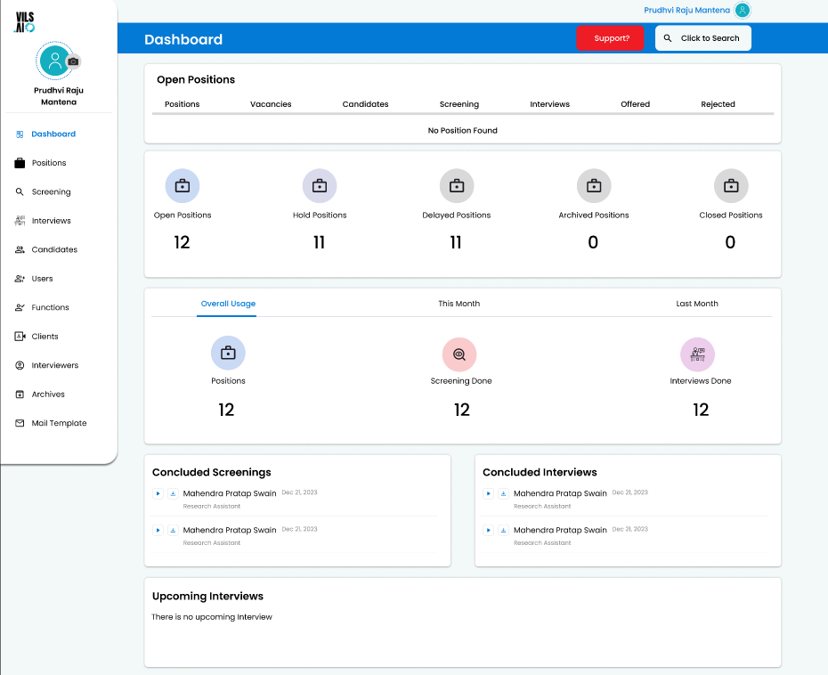
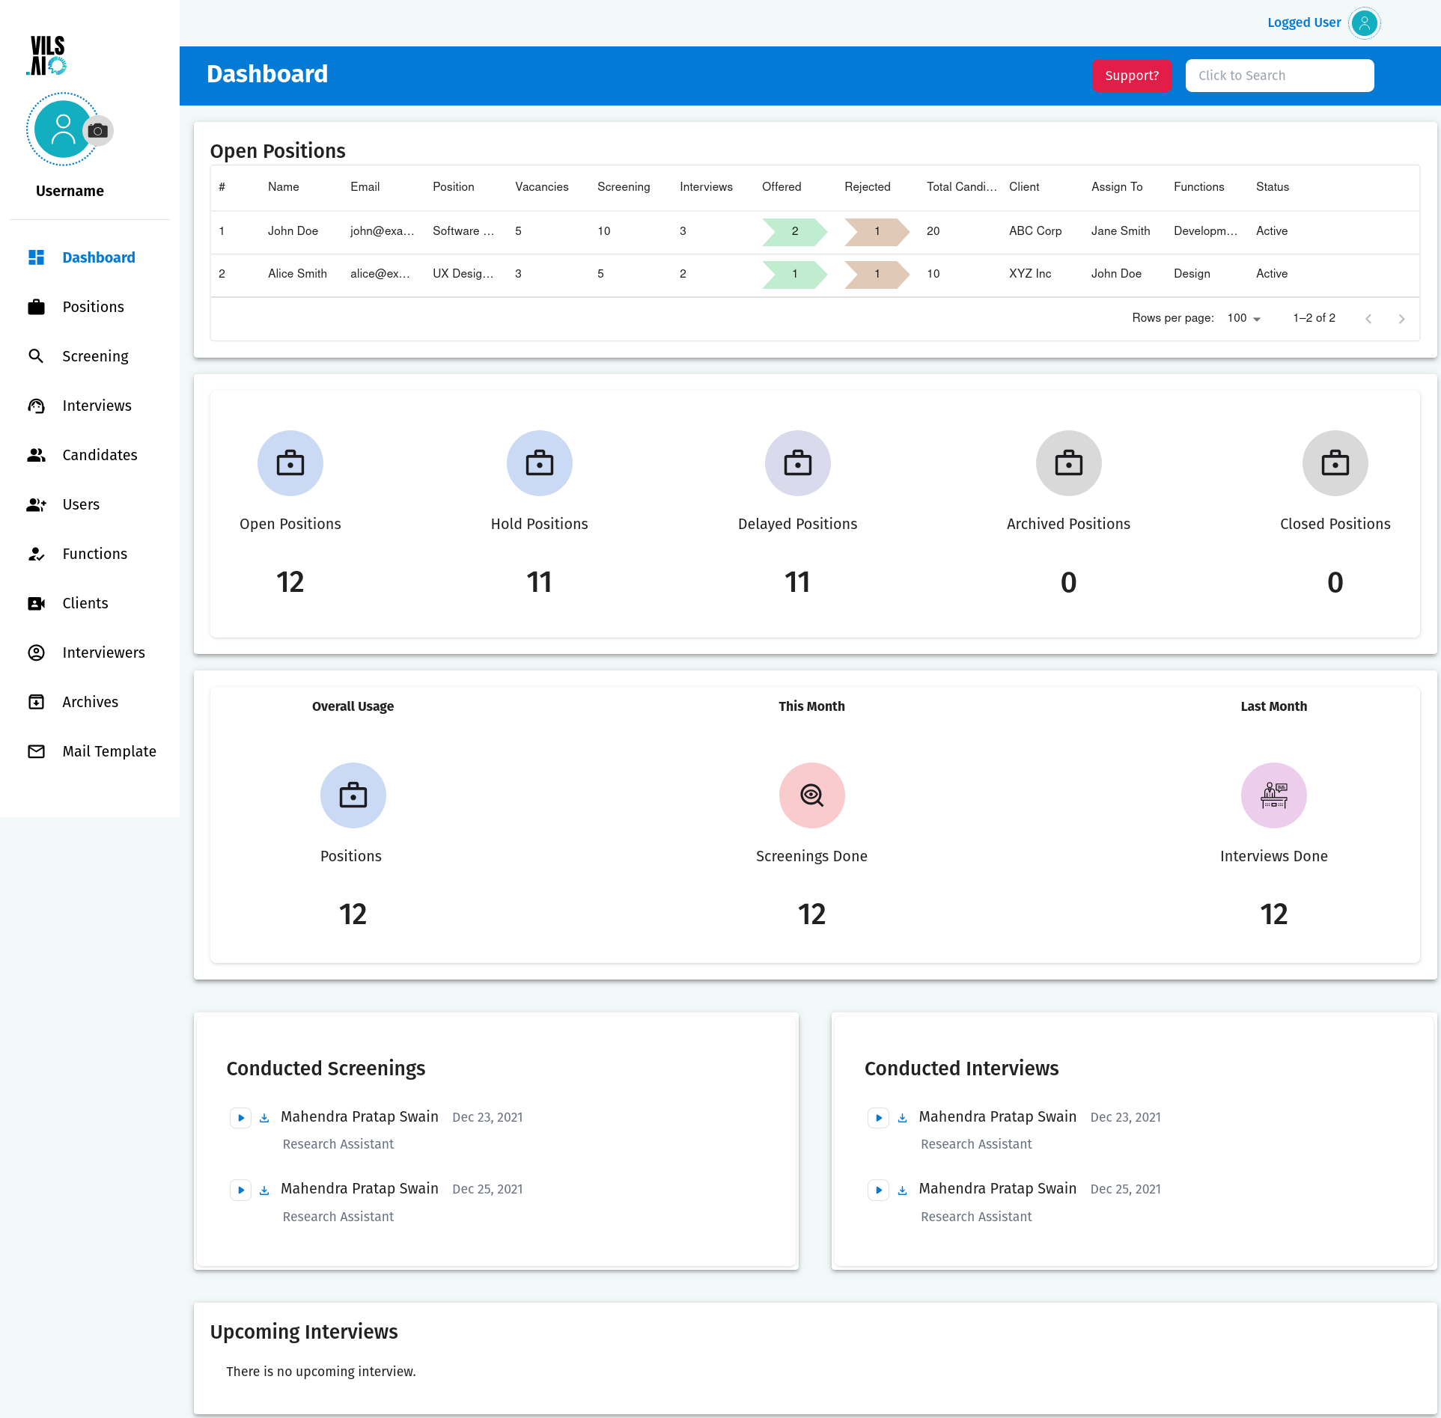
(Frontend) Figma vs Result
(Could not add more pages due to NDA)

Slide 6






Technologies Used

Slide 7







Frameworks and Other Tools

Slide 8

Rationale behind these tools:
Open Source – All of these tools are open-source. There is extensive documentation available online and a vibrant community of contributors to help address issues.
Industry Standard – All these tools were approved/suggested by our Client. This gave us an assurance that we are using industry-standard tools.
Easy to work with – The learning curve for these tools is not as steep as some others. Since most of these tools were completely new to us, understanding them well helped in increasing our efficiency.

Slide 9
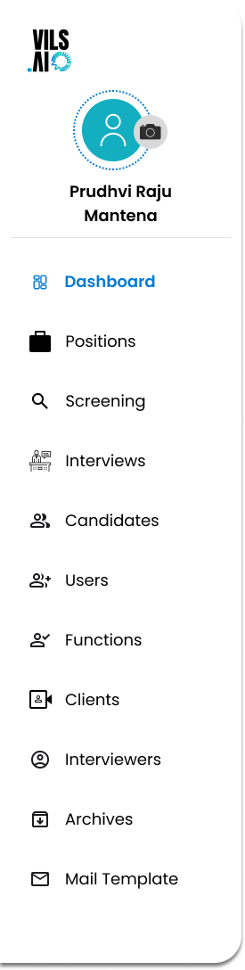
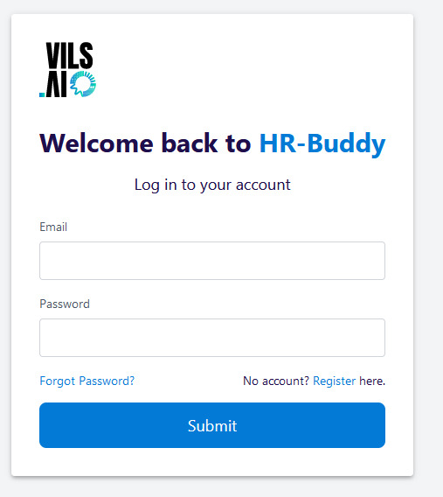
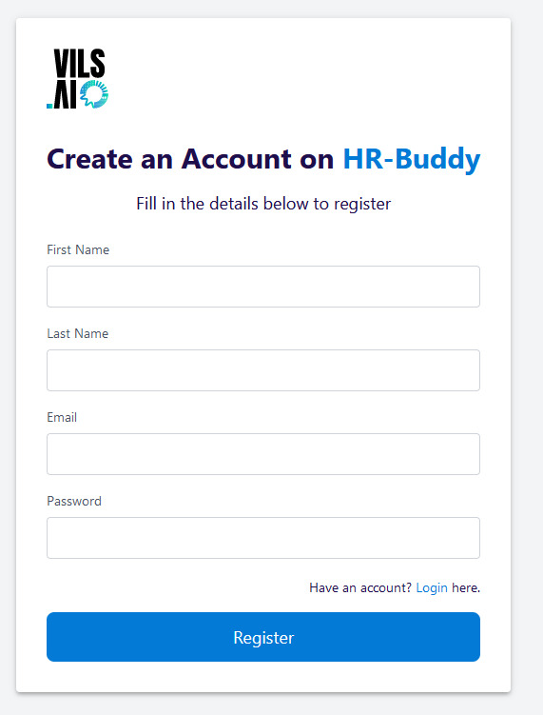
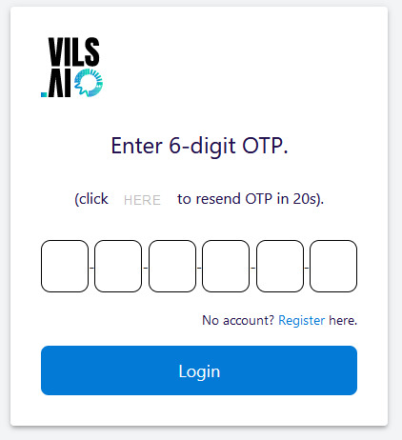
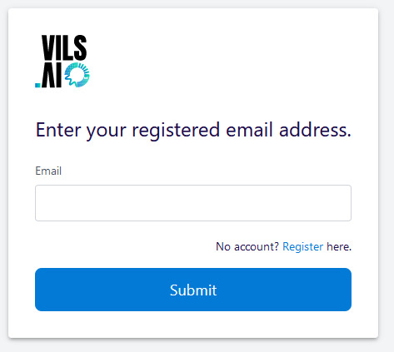
R1 Progress (Frontend)
All the pages visible in the sidebar have been completed
(cannot present them due to NDA)

Slide 10

Progress (Backend)
Users Module
Clients Module
Functions Module
Authentication and Authorization
Alembic Version Controlling
Refactoring the codebase in accordance with the Industry Standard

Slide 11
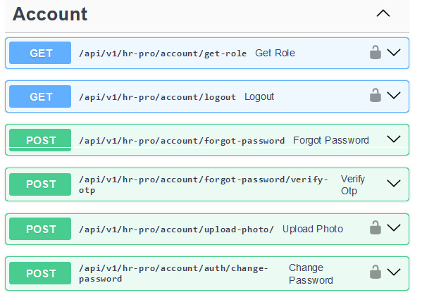
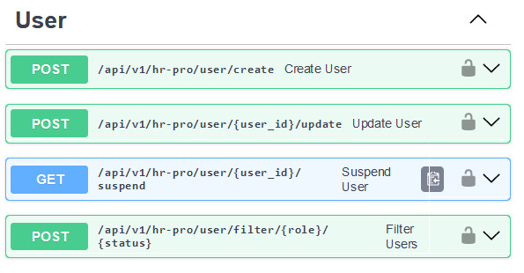
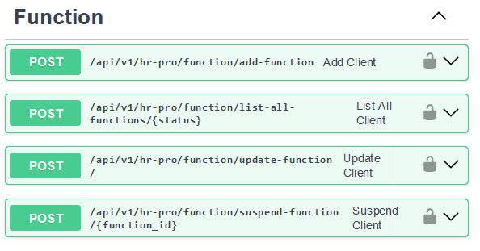
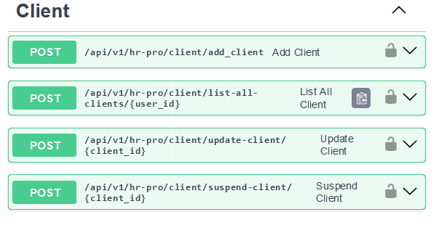
R1 Progress (Continued)

Slide 12
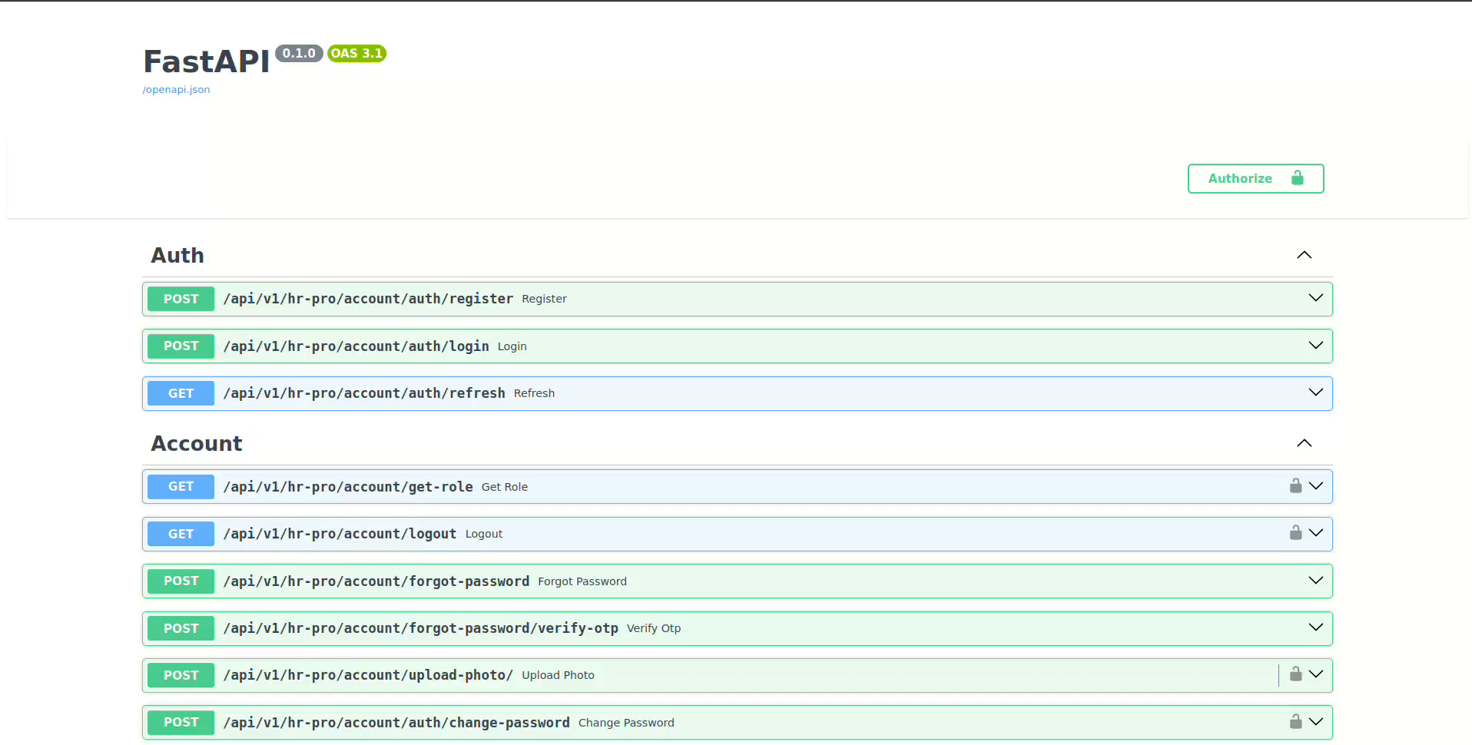
Some APIs demonstrated:

Slide 13
Some key features:
Reusing as many components as possible – faster render time for the front-end side.
Modularization of code and extensive documentation – Helped in collaborating amongst ourselves and lessen the learning curve for the backend and frontend teams during integration.
Multiple refactors – The code has been refactored multiple times to keep in accordance with the industry standard to the best extent, with specific emphasis on robustness and scalability.
Focus on efficiency of retrieval – Efficient data structures and database querying techniques have been used (Multiple joins, Trees etc.) to ensure fast and efficient C.R.U.D. operations.

Slide 14

Problems (WE) Faced
Lot of Merge Issues (Divergent Branches)
Meeting the Production Level Expectations from the client (client needed INDUSTRY standard code)
Legacy Python Dependencies
Following Figma Closely
Not having a containerized way to build everything again
Problem in understanding the OAUTH2 protocol and middleware in the initial stages, and hence needed to work on them multiple times later
Lack of communication at times (between teammates and/or the Client).

Slide 15
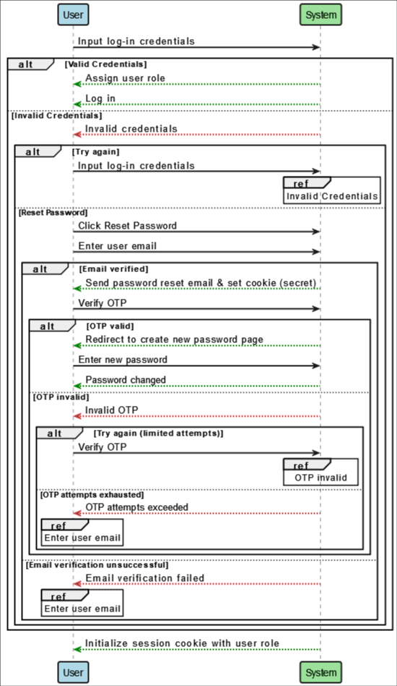
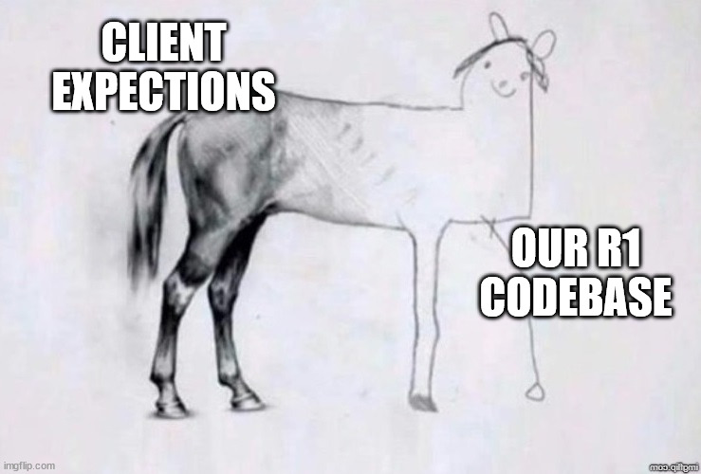
Plans for R2
Heavy emphasis on improving the Code Standards (Client needs Production Level Code)
Complete Integration of all the modules
Re-improvising Styles to match very close to Figma Files provided by the Client
Other Requirements (Multiple Pathways) (NDA)

Slide 16
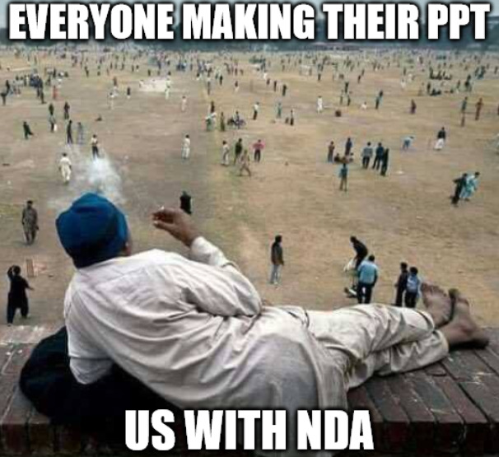

Thank You!!

